Slide 1

FINE TUNING: FALCON-7B LLM (TREC CAsT DATASET)
1
PRASUN DUTTA

Slide 2
CONVERSATIONAL SEARCH
2
Conversational Search enables arbitrary questions and answers over user’s document. It uses our documents to find content relevant to a given question, and it uses large language model to generate text from that relevant content.
Neither the question nor the generated answer exist verbatim (in exact wordings) in our knowledge base. The generated answer is still grounded in our knowledge base. Users ask questions conversationally, with the answers grounded in a knowledge base search, hence we call this Conversational Search [1].
This approach is also known as Retrieval Augmented Generation (RAG). The system does the following: Given this context (retrieved from a search query), answer this question (augment the search result with generated text).
This is an improvement over traditional search which gives a passage, not an answer.

Slide 3
TREC CAsT DATASET
3
There are currently few datasets appropriate for training and evaluating models for Conversational Information Seeking (CIS). The main aim of Text Retrieval Conference for Conversational Assisstance Track (TREC CAsT) is to advance research on conversational search systems. The goal of the track is to create a reusable benchmark for open-domain information centric conversational dialogues [2].
The structure of TREC CAsT Dataset (2022) consists of [3]:
number: This appears at the top level of the JSON object and represents the unique identifier for each conversation.
turn: This is an array that contains the individual turns in the conversation. Each turn is represented as an object with the following keys:
number: A unique identifier for the turn within the conversation, often indicating the sequence of the turns (e.g., "1-1" for the first turn, "1-2" for the second, etc.).
parent: (Optional) This indicates the parent turn to which the current turn is responding. For example, "1-2" is a response to "1-1".
participant: This indicates who is speaking at this turn, such as "User" or "System".
utterance: This is the original statement or question made by the participant.
automatic_rewritten_utterance: This is a rewritten version of the original utterance, possibly for clarity or to provide a more concise version of the question or statement.
response: (Only in turns where the participant is "System") This is the reply given by the system in response to the user's utterance.
provenance: (Only in turns where the participant is "System") This lists sources or references that the response is based on, usually provided as a list of identifiers.

Slide 4
OBJECTIVES
4
To fine-tune Falcon-7B LLM using TREC CAsT dataset.
The fine-tuning needs to be done keeping memory and GPU constraints in mind. Hence, we will be using the methods offered by PEFT library specifically – LoRA & QLoRA.
To keep track of the training loss.
We will be doing model inferencing.
Discussing on further improvements or implementations.

Slide 5
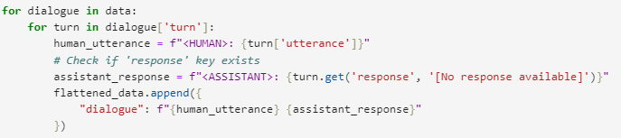
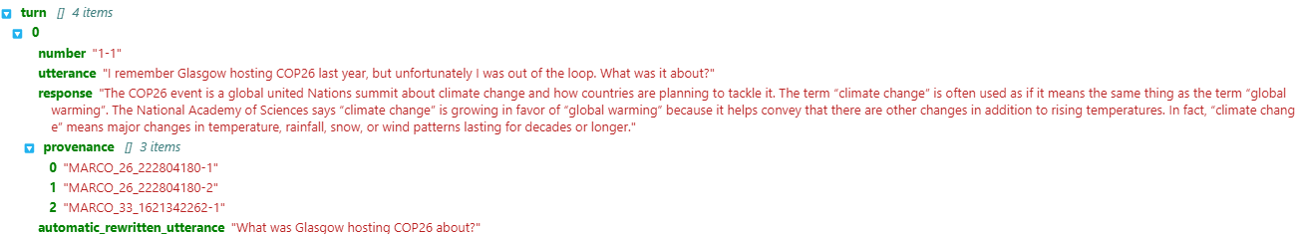
I. LOADING DATASET
5
In our original dataset we have tons of key value pairs. For our fine-tuning purpose we chose to keep only utterance (user query) and response (system answer) key value pairs. We renamed it to <HUMAN> and <ASSISTANT> pairs respectively as a list of dialogue objects for easier readability.
Code Snippet 1: Making changes to our original dataset
Fig 1: Structure of Original Dataset
Fig 2: Structure of Dataset after making the changes

Slide 6
II. INSTALLING LIBRARIES FOR QLoRA
6
Code Snippet 2: Installing libraries for QLoRA
bitsandbytes - for quantization of LLM
peft - for fine-tuning of LoRA parameters
datasets - for loading of HF datasets
wandb - for monitoring of fine-tuning metrics
trl - for training transformer LLMs with supervised fine-tuning steps
transformers - provides state-of-the-art machine learning models for natural language processing (NLP), including BERT, T5, Falcon and many others
accelerate - helps streamline and optimize the training of PyTorch models, especially for distributed and mixed-precision training
einops - library for flexible and readable tensor operations. It simplifies complex tensor manipulations by providing a high-level, readable syntax

Slide 7
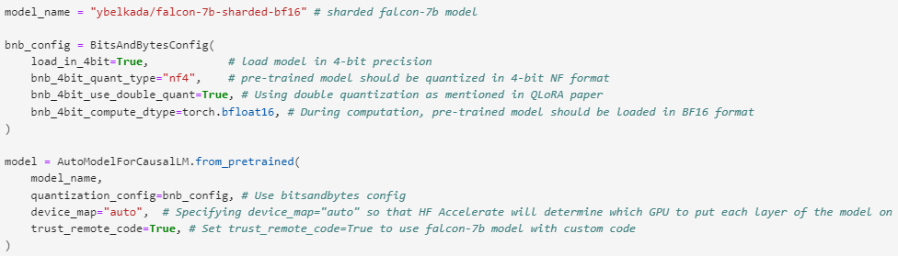
III. QUANTIZATION OF FALCON-7B MODEL
7
We load a sharded model instead of one single large model. The advantage of using a sharded model is that when combined with accelerate, that helps accelerate to take a particular piece and then move it to different parts of memory sometimes CPU or GPU, and hence that helps fine-tune a large model in smaller amounts of memory [4]. We have used ybelkada/falcon-7b-sharded-bf16 sharded model.
Code Snippet 3: Quantization of Falcon-7B model

Slide 8
III. QUANTIZATION OF FALCON-7B MODEL
8
The BitsAndBytesConfig configures the quantization process for a model, specifying that it should use 4-bit quantization with the NF4 data type and compute using the torch.bfloat16 data type. The nested quantization technique is also enabled for enhanced memory efficiency [6].
load_in_4bit = True: This argument indicates that the model should be loaded in 4-bit quantization. By doing so, memory usage can be reduced by approximately fourfold.
bnb_4bit_use_double_quant = True: This argument suggests using the nested quantization technique, which offers even greater memory efficiency without compromising performance.
bnb_4bit_quant_type = "nf4": The NF4 data type is designed for weights initialized using a normal distribution. By specifying this type, the model uses the NF4 data type for quantization.
bnb_4bit_compute_dtype = torch.bfloat16: This argument allows us to modify the data type used during computation. By setting it to torch.bfloat16, it can result in speeding improvements in specific scenarios.

Slide 9
III. QUANTIZATION OF FALCON-7B MODEL
9
Code Snippet 4: Loading the tokenizer from the pre-trained model and setting pad_token to eos_token
We first load the tokenizer from the pre-trained model to tokenize the dataset.
We then set pad_token equal to eos_token in order to enable padding. It pads the sequences to match the length of the longest sequence in our batch. But, instead of being treated as a padding token it will be treated as a end of sequence token [5].

Slide 10
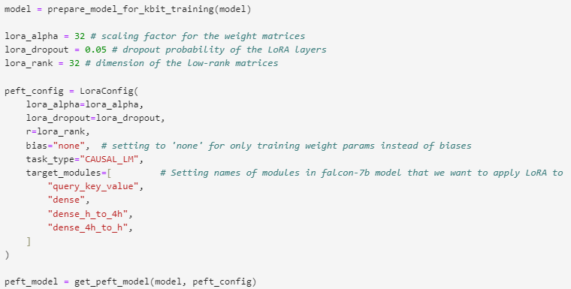
IV. CONFIGURATION SETTINGS FOR PEFT MODEL AND GET PEFT MODEL
10
Code Snippet 5: Configuration settings for PEFT model and get PEFT model

Slide 11
IV. CONFIGURATION SETTINGS FOR PEFT MODEL AND GET PEFT MODEL
11
LoraConfig is used to store the settings for a LoRA model, which is designed for fine-tuning a model with LoRA (Low Rank Adapters). The provided parameters are essential for determining how the LoRA layers behave during the fine-tuning process [7].
lora_alpha (int): This parameter represents the scaling factor for the weight matrices in LoRA, which is adjusted by alpha to control the magnitude of the combined output from the base model and low-rank adaptation.
lora_rank (int): This represents the LoRA rank of the update matrices, expressed in int. Lower rank results in smaller update matrices with fewer trainable parameters.
lora_dropout (float): This parameter indicates the dropout probability for LoRA layers. Dropout is a regularization technique where randomly selected neurons are ignored during training, helping to prevent overfitting. In this configuration, the dropout rate is set to 0.05 or 5%.
NOTE
The weight matrix is multiplied by lora_alpha/r, and a higher lora_alpha value assigns more weight to the LoRA activations.
For better performance, the HuggingFace docs recommend setting bias to None first, and then lora_only, before trying all.

Slide 12
IV. CONFIGURATION SETTINGS FOR PEFT MODEL AND GET PEFT MODEL
12
bias (str): This parameter specifies the bias type for LoRA. It can take values such as ‘none’, ‘all’, or ‘lora_only’. If set to ‘all’ or ‘lora_only’, the corresponding biases will be updated during training. This means that even when disabling the adapters, the model might not produce the same output as the base model would have without adaptation. In the given code, the bias is set to “none”, meaning no bias is used.
task_type (str): This parameter indicates the type of task for which the model is being fine-tuned. In the provided code, it’s set to CAUSAL_LM, which stands for Causal Language Modeling.
target_modules (str): In order to consider all linear layers in the Transformer block for maximum performance, we have added “dense”, “dense_h_to_4h”, and “dense_4h_to_h” layers as target modules in addition to the mixed query key-value pair.
prepare_model_for_kbit_training: This method outlines the protocol for preparing a model prior to training. The steps include casting layernorm in fp32, requiring gradients for output embedding layer, and upcasting the LLMs head to fp32.

Slide 13
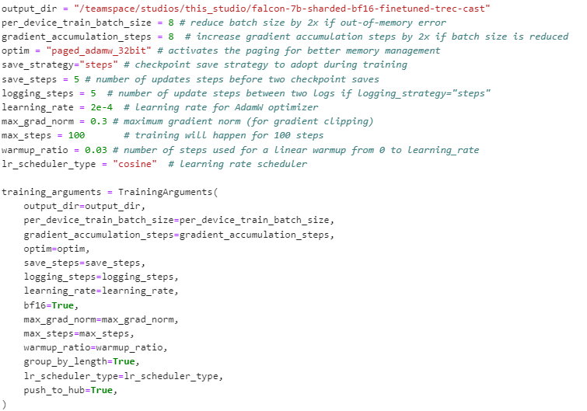
V. CONFIGURATION SETTINGS FOR
13
TRAINING ARGUMENTS AND TRAINER
Code Snippet 6: Configuration settings for Training arguments

Slide 14
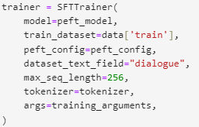
V. CONFIGURATION SETTINGS FOR
14
TRAINING ARGUMENTS AND TRAINER
The SFTTrainer (Supervised Fine-tuning Trainer) is a class provided by the TRL (Transformers Reinforcement Learning) library.
The SFTTrainer provides an easy-to-use API to create and train SFT models with just a few lines of code on a given dataset.
When initializing the SFTTrainer class, we pass the following:
base model to be trained
the training dataset
PEFT configurations
and the method for converting the training data into a “prompt”
Code Snippet 7: Configuration settings for Trainer

Slide 15
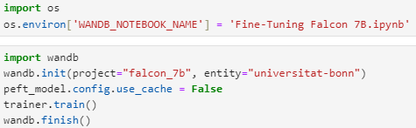
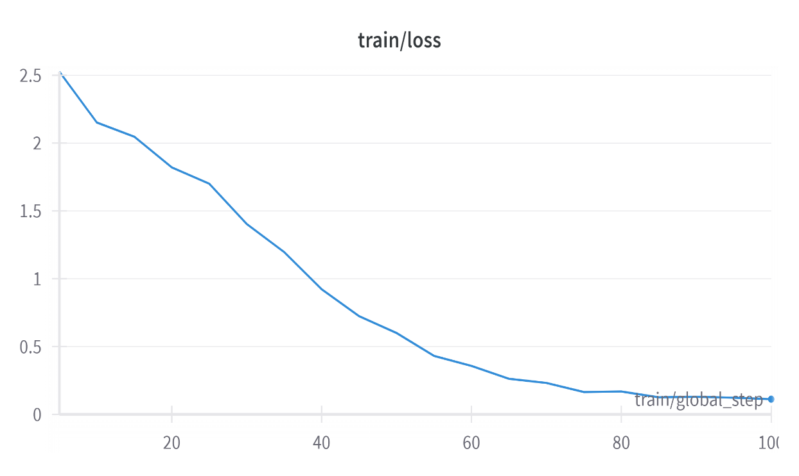
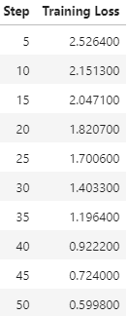
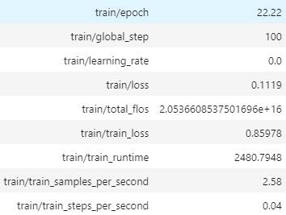
VI. TRAINING & TRACKING TRAINING LOSS
15
Code Snippet 8: Training & Tracking Training Loss
Fig 3: Training Summary & Training Loss

Slide 16
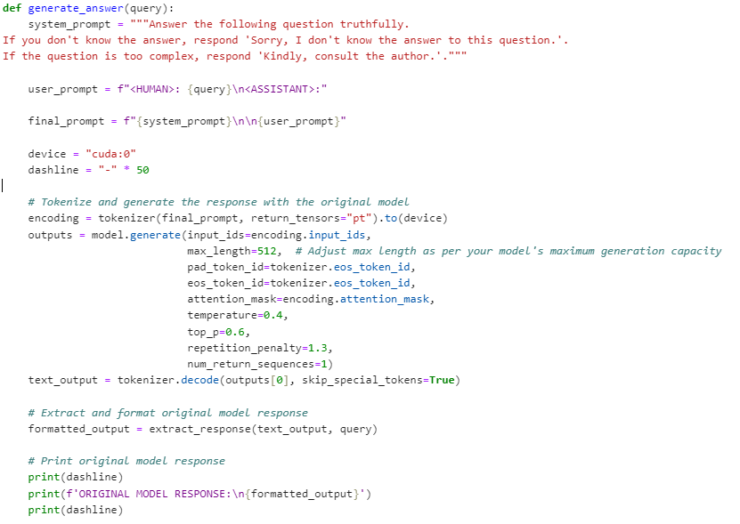
VII. INFERENCE PIPELINE FOR PEFT MODEL
16
Code Snippet 9: Generating Original Model Response

Slide 17
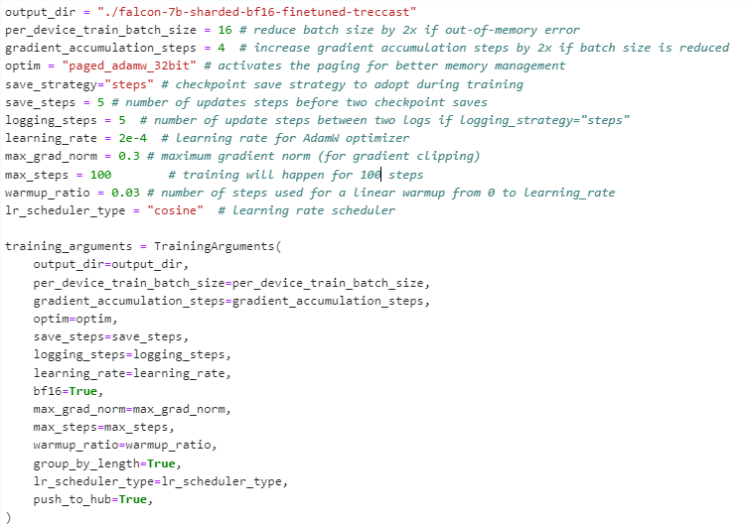
VII. INFERENCE PIPELINE FOR PEFT MODEL
17
Code Snippet 10: Generating PEFT Model Response

Slide 18
VII. INFERENCE PIPELINE FOR PEFT MODEL
18
We created a model inference function for both the Original Sharded Model and PEFT Tuned Model to compare the results.
For model response generation, we have set temperature as 0.6, top_p as 0.7 and repetition_penalty as 1.2.
Temperature is a parameter used to control the level of creativity in AI-generated text. A temperature of 1 means the model is more creative, and a temperature of 0 means the model is more focused and deterministic.
Top_p also known as Nucleus Sampling, is a parameter used to control the range of tokens considered by the model based on their cumulative probability. A low top_p means the model will consider only tokens with the highest cumulative probability. A high top_p means the model will consider all tokens, including those with lower probabilities.
The PEFT model seems to hallucinate less and generate a more coherent response in contrast to the Original Sharded Model

Slide 19
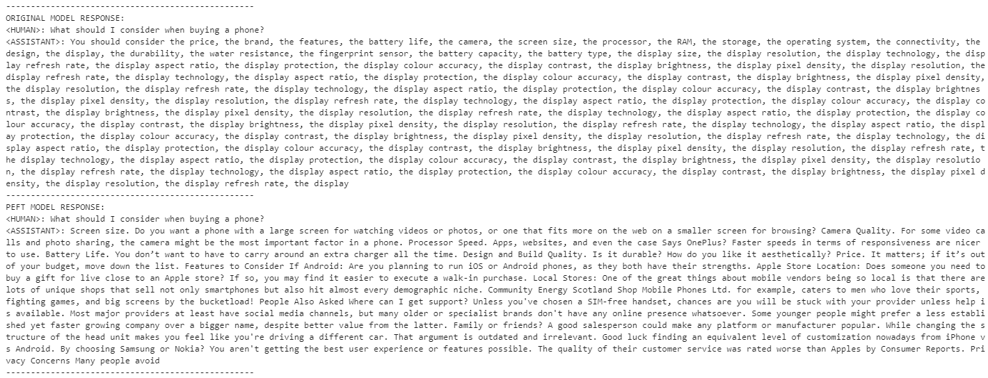
VII. INFERENCE PIPELINE FOR PEFT MODEL
19
Fig 4: Original VS PEFT Model Response

Slide 20
REFERENCES
20
[1] Azzopardi, L., Dubiel, M., Halvey, M., & Dalton, J. (2024). A conceptual framework for conversational search and recommendation: Conceptualizing Agent-Human Interactions during the Conversational Search process. arXiv.org. https://arxiv.org/abs/2404.08630
[2] Dalton, J., Xiong, C., & Callan, J. (2020). TREC CAST 2019: The Conversational Assistance Track Overview. arXiv.org. https://arxiv.org/abs/2003.13624
[3] Text REtrieval Conference (TREC) overview. https://trec.nist.gov/overview.html
[4] vilsonrodrigues/falcon-7b-sharded · Hugging Face. (2023). https://huggingface.co/vilsonrodrigues/falcon-7b-sharded
[5] https://huggingface.co/docs/transformers/en/model_doc/auto
[6] Quantization. https://huggingface.co/docs/accelerate/en/usage_guides/quantization
[7] Younes Belkada, Tim Dettmers, Artidoro Pagnoni, Sylvain Gugger, Sourab Mangrulkar. (2023). Making LLMs even more accessible with bitsandbytes, 4-bit quantization and QLoRA. https://huggingface.co/blog/4bit-transformers-bitsandbytes

Slide 21
21
THANK YOU

